Slide 1
Electric current
Physics 1
Ing. Jaroslav Jíra, CSc.

Slide 2
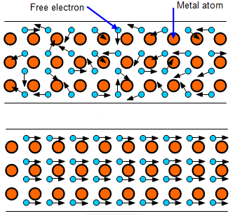
Electric Current
Valence electrons in an atom are the outermost electrons, the least bound to the central positive charge.
In a solid substance, there is often a crystalline structure of the atoms or molecules, the atoms or molecules form a lattice in space.
Valence electrons are free to move within the lattice, so the motion of such electrons without external electric field is similar to the motion of molecules in a gas.
If we connect a battery to the metallic conductor, an electric field $\vec{E}$ will be set up in the conductor.
$$\vec{E}=0$$
This field will act on the electrons and will cause their motion in the direction of -$\vec{E}$. An electric current is established. The ability of conductors to carry an electric current is called conduction of free electrons.
$$\vec{E}≠0$$

Slide 3
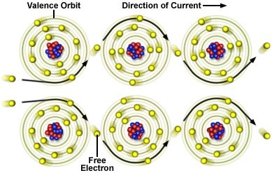
Electric Current
The average electric current in a conductor is defined as
where ΔQ is the net amount of charge that passes through a cross section of the conductor during the time interval Δt.
If the current is not constant in time, we can define instantaneous current as a limit
The unit of electric current is Ampere [A]
We could also write inversely

Slide 4
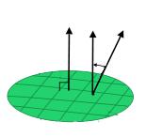
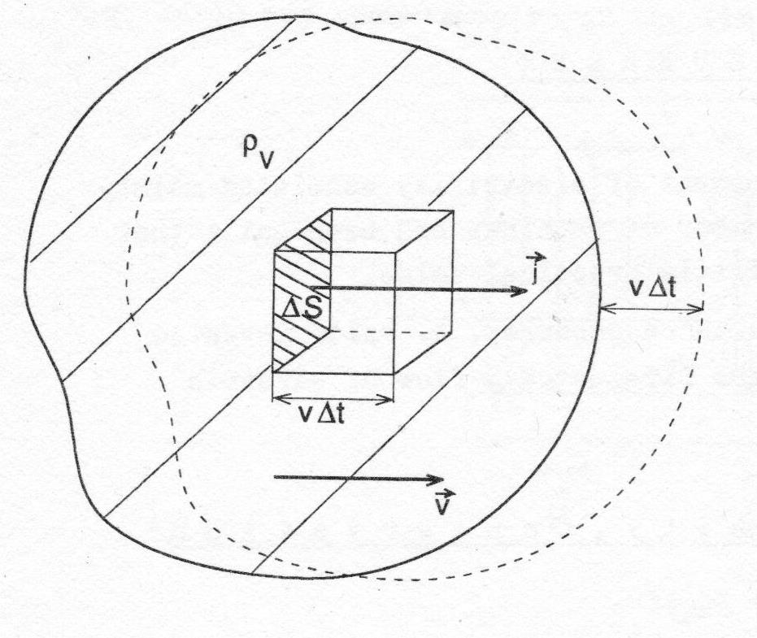
Current Density
To describe motion of charges it the 3D volume, we need another quantity, called current density $\vec{j.}$ Unit of the current density is [A/m²].
The current passing through an elementary surface area dS is
$$\vec{S}$$
$\vec{n}$₀
α
S
The current passing through an area S is
dS
Let us suppose that the average motion of charges is a drift with velocity $\vec{v}$passing through a surface element ΔS. The charge ΔQ passing through ΔS in a time Δt is equal to the charge contained in a prism of the volume ΔS·v·Δt.

Slide 5
Current Density
If we multiply the volume of the prism by the charge volume density ρ_{V}, we obtain
The charge per unit volume is an electric current, so by introducing differentials instead of deltas we obtain
Considering
we can write
If there are n charges in the unit volume, each with unit charge e and they are moving with mean velocity $\vec{v}$, we can rewrite the formula for the current density to

Slide 6
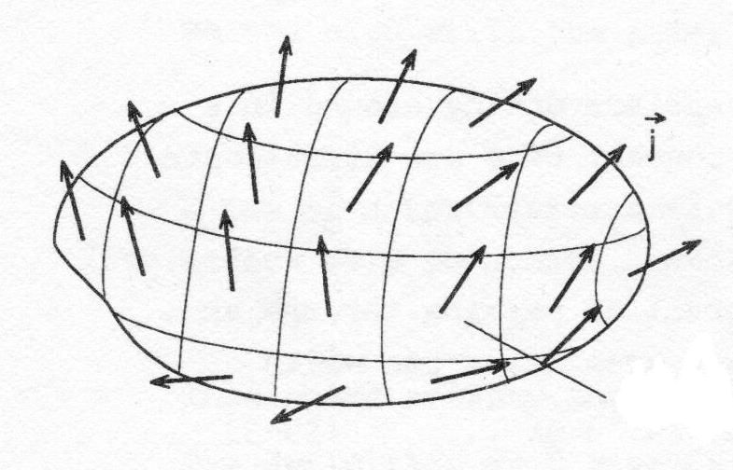
Current Density
The current I out of a closed surface represents the rate at which the charge leaves the volume V enclosed by S. Since the charge cannot be created or destroyed the amount of charge inside V must decrease. We can write the law of conservation of charge inside Q_{in}.
Closed surface
where
By shrinking down the volume around a point (x,y,z) we obtain
No charge can flow away from a place without diminishing the amount of charge that is there.

Slide 7
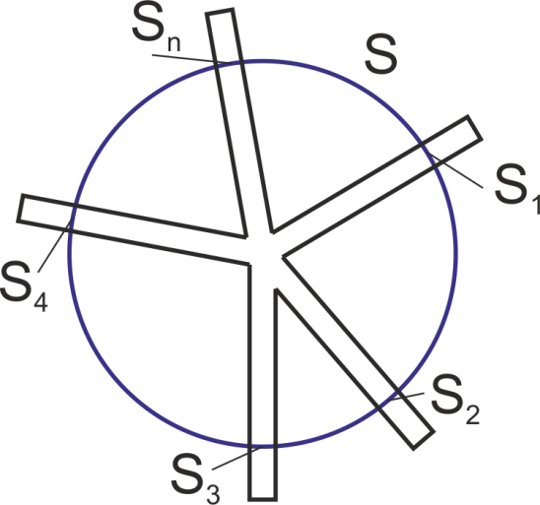
First Kirchhoff’s Law
Let us suppose stationary case when a volume charge density is constant. The law of charge conservation will change to
This equation can be rewritten according to particular currents flowing through areas S₁, S₂, … S_{n} into the volume surrounded by S.
The first Kirchhoff’s law can be formulated: the algebraic sum of all currents into the junction point must be zero.

Slide 8
Ohm’s Law, Resistance, Conductivity
If we want to establish an electric current in a circuit, we need a potential difference. G. S. Ohm established experimentally that the current I in metal wire is proportional to the potential difference V.
where R is the resistance of the wire.
Unit of R is Ohm [Ω]
The Ohm’s law expressed in words: current through a metal conductor is proportional to the applied voltage. This means that R is considered a constant, which is valid in case of metal wires or resistors, but we cannot use the Ohm’s law for semiconductor elements, light bulbs and other devices, which are called nonohmic or nonlinear.
Another experimental finding is that the resistance of uniform metal wire is directly proportional to its length l and inversely proportional to its cross-sectional area S.
where ρ is resistivity in [Ω·m] and it depends on the material used

Slide 9
Ohm’s Law, Resistance, Conductivity
The resistivity depends on the material used and also on the temperature.
where ρ_{T} is resistivity at temperature T, ρ₀ is resistivity at a standard temperature T₀, and α [K⁻¹] is the temperature coefficient of resistivity.
The reciprocal value of resistivity is called conductivity γ
Let us deduce the Ohm’s law in differential form now. We will start with
the formula for electric field E in the wire of length l and potential difference V at its ends.
If we substitute for V from the Ohm’s law
Now we substitute for R with resistivity formula and realize that I=j·S
The Ohm’s law in differential form

Slide 10
Properties of Conducting Materials
Material | Resistivity ρ [μΩ·cm] | Temp. coef α [mK⁻¹]
Silver | 1.63 | 3.8
Copper | 1.75 | 6.8
Gold | 2.35 | 3.7
Aluminum | 2.83 | 4.9
Zinc | 5.9 | 3.8
Brass | 7.5 | 2-7
Iron | 9.8 | 6
Platinum | 10.9 | 3.9
Carbon | 33-185 | -6 to +1.2
Tin | 11.5 | 4.2
Constantan (Cu+Ni+Mn) | 49 | -0,03

Slide 11
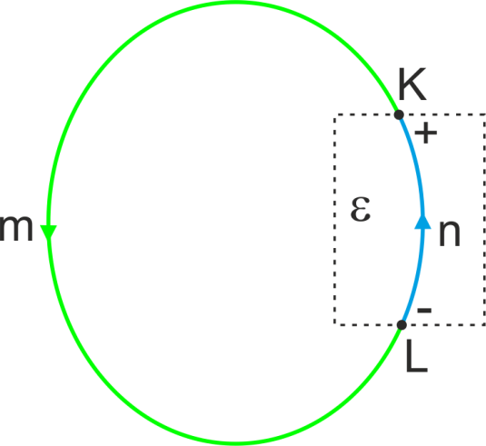
Electromotive Force
Let us suppose that we have an electric circuit containing a seat of emf ε (e.g. a wire moving in magnetic field). The flow of charges can be described by the Ohm’s law
where E_{S} is an electric field causing the flow of charges outside the seat in the part m and E_{I} is electric field inside the seat – part n.
After small arrangements we obtain
[1]
If we now realize that the motion of charges in the part n is influenced both by E_{S} and E_{I}, while in the part m the value of E_{I} =0, we can rewrite the right side

Slide 12
Electromotive Force
Since we know that
we can simplify the equation [1] to
where the term
is the electromotive force
Now we can separate also the left part of the equation [1]
Realizing that vectors $\vec{j}$ and $d\vec{l}$ are colinear and
we can write

Slide 13
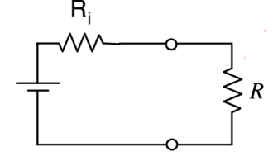
Electromotive Force
Similarly we could deduce
so
The equation [1] can be then rewritten to
We can imagine it as a simple electric circuit with voltage source ε, internal resistance R_{i} and load R. The emf seat includes both the source and R_{i}. The voltage on its terminals KL can be written as
K
ε
L
Example: ε=10V, R_{i}=0.5 Ω, R=5Ω.

Slide 14
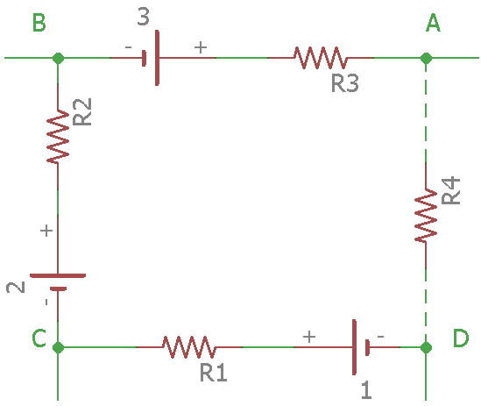
Second Kirchhoff’s Law
We have a closed electric circuit consisting of junctions A-B-C-D and branches connecting them consisting of resistors and emf forces.
ε
We already know that
[2]
ε
We can now rewrite integrals on both sides.
ε

Slide 15
Second Kirchhoff’s Law
Both sides of the equation [2] can be simplified into the general form
or
Where n is the number of branches.
The second Kirchhoff’s law can be formulated: the algebraic sum of changes in potential around any closed path of the circuit is zero.

Slide 16
Energy Transfers in an Electric Circuit
We have a simple circuit consisting of battery B with its internal resistance R_{i} and between its terminals KL we have a resistor R as a load. The electric current flowing through the circuit is I. The elementary energy transformed (consumed) by the resistor R is
I
K
ε
V
L
where V is the voltage on the resistor R and dq is elementary charge passing through the R.
If dt is elementary time necessary for passing the dq through the R, then the power consumed by the R is
Using the Ohm’s law we can rewrite the formula to the form of Joule’s law.

Slide 17
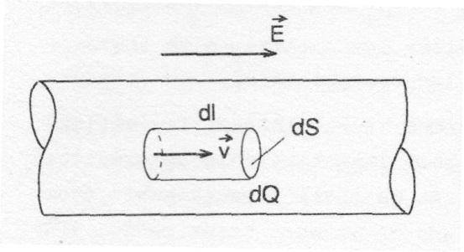
Joule’s Law From the Microscopic Point of View
We have a conductor connected to a battery. The electric field $\vec{E}$ acts on the charged particles so that they move with constant velocity $\vec{v}$. Now we choose an elementary volume dV=dS·dl. We can define the power density
From the mechanics and electrostatics we know that
and
so
For the stationary state we can consider $\vec{E}$ and $\vec{v}$ constant, so
where ρ_{V} is volume charge density

Slide 18
Joule’s Law From the Microscopic Point of View
From the current density chapter we know that
and
where n is number of charges in the volume dV and e is elementary charge.
We can finally write for the power density
This relation is also called Joule’s law from the microscopic point of view.
The total energy used by a device during time t can be written as

Slide 19
Summary – what we have learnt
Relations between electric charge and current
Current density relations
First Kirchhoff’s law
Second Kirchhoff’s law
Ohm’s law
Resistivity
Joule’s law

Slide 20
Maxwell’s Equations – integral form
1. Ampere’s law
2. Faraday’s law
3. Gauss’s law of electricity
4. Gauss’s law of magnetism
Constitutive relations
The term in the Ampere’s law represents a displacement current.

Slide 21
Maxwell’s Equations – differential form
To be able to transform Maxwell’s equation into the differential form, we need two fundamental theorems of the vector calculus.
Gauss’s theorem (divergence theorem)
Stokes’s theorem
Explanation of symbols
Nabla (or del) operator
Divergence of the vector $\vec{F}$
Curl of the vector $\vec{F}$

Slide 22
Maxwell’s Equations – differential form
1. Transformation of the Ampere’s law
Using the Stokes’s theorem we have
2. Transformation of the Faraday’s law
Using the Stokes’s theorem we have

Slide 23
Maxwell’s Equations – differential form
3. Transformation of the Gauss’s law of electricity
Using the Gauss’s theorem we have
4. Transformation of the Gauss’s law of magnetism
Using the Gauss’s theorem we have

Slide 24
Maxwell’s Equations in both forms
Integral
Differential

