Slide 1
Electrostatics
Physics 1
Ing. Jaroslav Jíra, CSc.

Slide 2
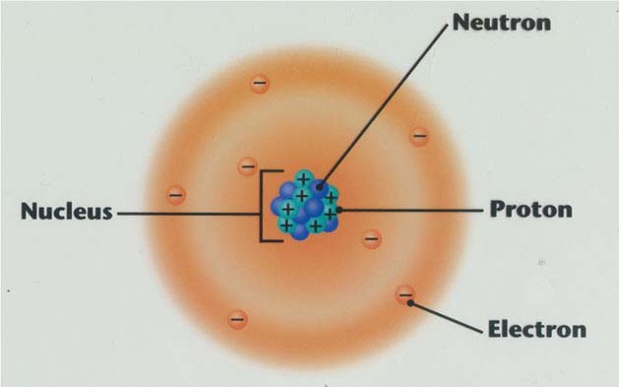
Electric Charge is the basis of electricity.
The charge on an atom is determined by the subatomic particles an atom consists of.
Elementary charge
e = 1.602 x 10⁻¹⁹ C
Proton - has a positive charge (+e) and is located in the nucleus.
Neutron - has no charge (is neutral) and is also located in the nucleus as it fills in the spaces between the protons.
Electron - has a negative charge (-e) and is located outside of the
nucleus in an electron cloud around the atom.

Slide 3


Numbers Concernig an Atom
Diameter of a nucleus – 1 fm = 10⁻¹⁵ m (the smallest nuclei)
Diameter of an atom – 0.1 nm = 10⁻¹⁰ m (hydrogen atom)
Mass of a proton or neutron – m_{p}= 1.67 x 10⁻²⁷ kg
Mass of an electron – m_{e}= 9.1 x 10⁻³¹ kg
Charge of a proton – Q_{p}= +e= +1.602 x 10⁻¹⁹ C
Charge of an electron – Q_{e}= -e= -1.602 x 10⁻¹⁹ C
Frequency of electron revolution – f_{e}= 6.5 x 10¹⁵ Hz (first orbit)
Mass of a proton is 1835 times larger than that of an electron. The similar ratio, like masses of a melon and cherry.

Slide 4
Some Facts about Electric Charge
Charge is denoted as Q or q.
Charge has a fundamental unit of a Coulomb (C).
Charges can exist only in multiples of e (elementary charge).
One Coulomb is quite large unit:
A glass rod rubbed with piece of silk acquires a charge of 10 μC
A filtration capacitor in a DC source stores a charge of 1 mC
An average lightning bolt carries a charge of 15 C
Charge cannot be created or destroyed – charge conservation principle.
Atoms usually have as many electrons as protons, so the atom has a zero net charge (is electrically neutral).
An atom which loses some electrons becomes a positive ion.
An atom which acquires excessive electrons becomes a negative ion.

Slide 5
Conservation of Charge
Some materials tend to give up electrons and become positively charged and some materials tend to attract electrons and become negatively charged.
If we try to rub the glass rod with the silk cloth we find that positive charge appears on the rod. At the same time an equal amount of negative charge appears on the silk cloth, so that the net rod-cloth charge is actually zero. This means that rubbing does not create charge but only transfers it from one body to the other.
Charge conservation can be expressed by:
Net charge before = Net charge after
silk
silk
+
-
+
-
+
-
-
+
glass rod
glass rod

Slide 6
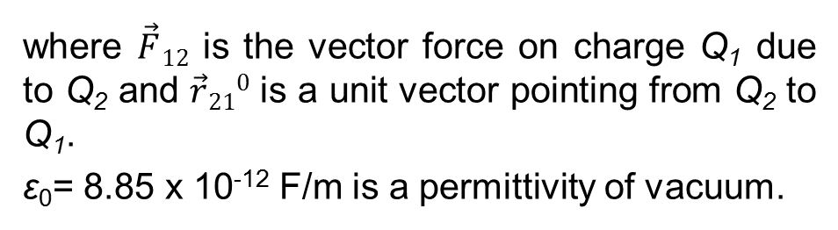
Coulomb’s Law
An electric charge exerts a force on the other charge. Ch. A. Coulomb found that the force is proportional to the product of both charges and inversely proportional to the square of their distance.
where $\vec{F}12$ is the vector force on charge Q₁ due to Q₂ and $\vec{r}210$ is a unit vector pointing from Q₂ to Q₁.
ε₀= 8.85 x 10⁻¹² F/m is a permittivity of vacuum.
A simplified notation of the Coulomb’s law is sometimes being used.

Slide 7
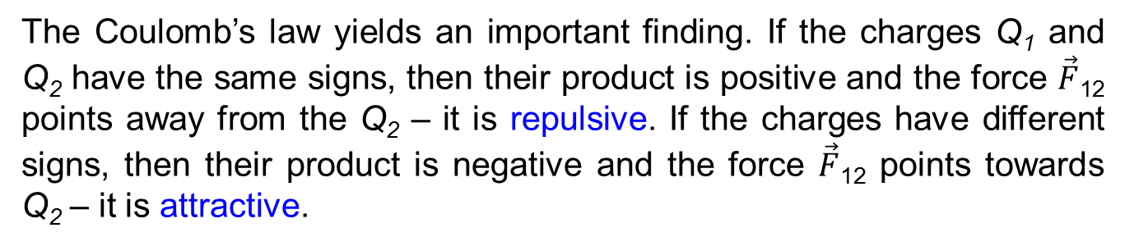
Coulomb’s Law
The Coulomb’s law yields an important finding. If the charges Q₁ and Q₂ have the same signs, then their product is positive and the force $\vec{F}$₁₂ points away from the Q₂ – it is repulsive. If the charges have different signs, then their product is negative and the force $\vec{F}$₁₂ points towards Q₂ – it is attractive.
We can summarize it by saying that like charges repel and unlike charges attract.
-
-
+
+
+
-

Slide 8
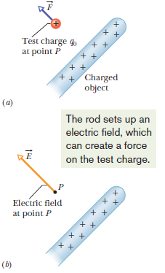
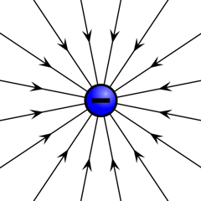
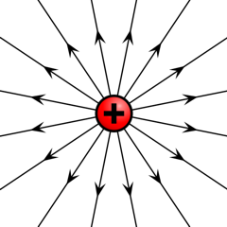
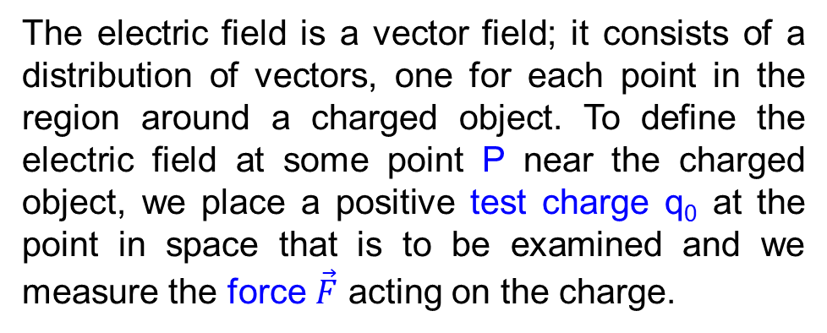
Electric Field
The electric field is a vector field; it consists of a distribution of vectors, one for each point in the region around a charged object. To define the electric field at some point P near the charged object, we place a positive test charge q₀ at the point in space that is to be examined and we measure the force $\vec{F}$ acting on the charge.
The electric field is defined as
It’s unit is
In order to visualize the electric field we draw a series of lines called electric field lines or force lines.
The electric field of a charged particle points radially away from the (+) charge or radially towards the (-) charge.

Slide 9
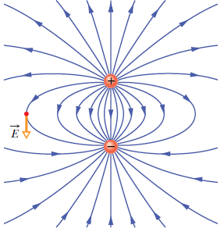
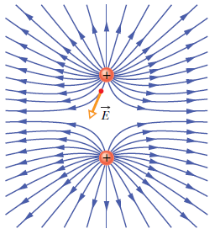
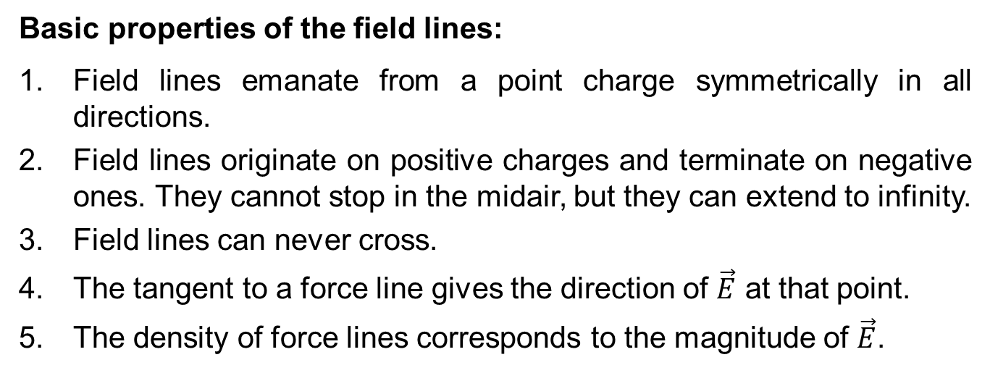
Electric Field
Basic properties of the field lines:
Field lines emanate from a point charge symmetrically in all directions.
Field lines originate on positive charges and terminate on negative ones. They cannot stop in the midair, but they can extend to infinity.
Field lines can never cross.
The tangent to a force line gives the direction of $\vec{E}$ at that point.
The density of force lines corresponds to the magnitude of $\vec{E}$.

Slide 10
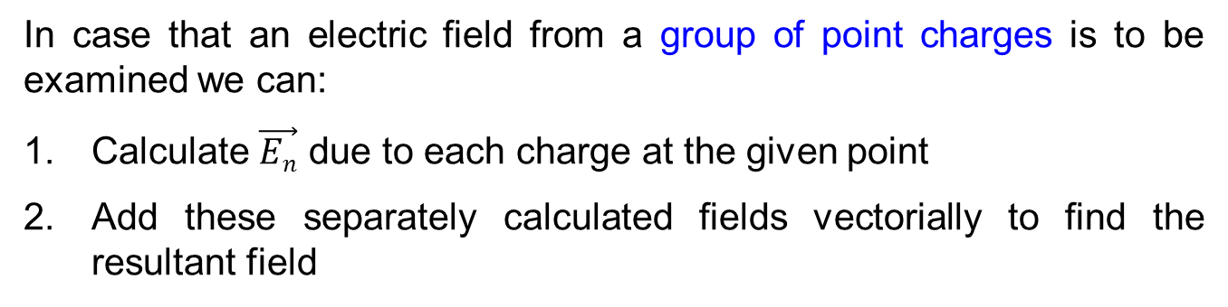
Electric field from a point charge Q
Let a test charge q₀ be placed at a distance r from a point charge Q. The magnitude of the force acting on q₀ is from the Coulomb’s law:
The magnitude of electric field at the position of the test charge is given by:
In case that an electric field from a group of point charges is to be examined we can:
Calculate $\vec{En}$ due to each charge at the given point
Add these separately calculated fields vectorially to find the resultant field

Slide 11
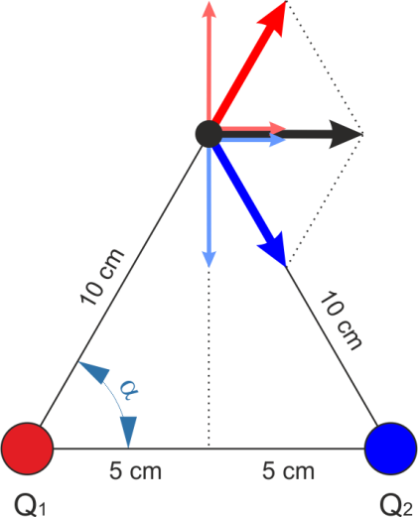
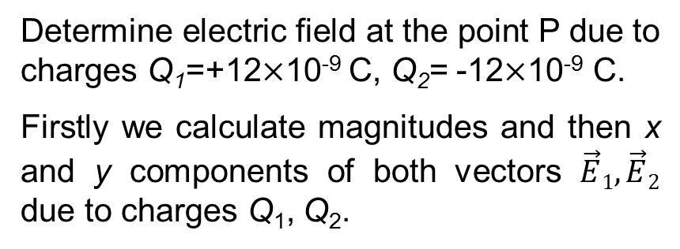



Example - Electric field from two charges (a dipole)
Determine electric field at the point P due to charges Q₁=+12$×$10⁻⁹ C, Q₂= -12$×$10⁻⁹ C.
Firstly we calculate magnitudes and then x and y components of both vectors $\vec{E}1, \vec{E}2$ due to charges Q₁, Q₂.
$$\vec{E}1$$
E_{1y}
P
E_{1x}
$$\vec{E}$$
E_{2x}
E_{2y}
$$\vec{E}2$$
Magnitudes E₁ and E₂ are equal due to the same distance and charge magnitude.
Answer: The magnitude of resulting electric field is 10790 V/m and the direction is parallel to the horizontal axis, positive direction.

Slide 12
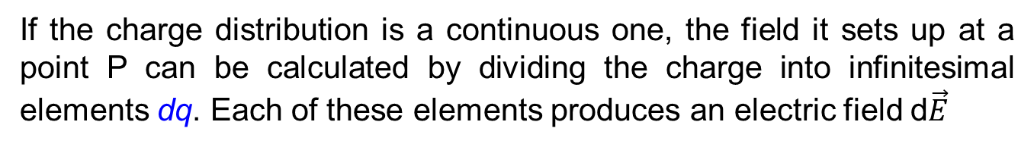
Electric field for the continuous charge distribution
If the charge distribution is a continuous one, the field it sets up at a point P can be calculated by dividing the charge into infinitesimal elements dq. Each of these elements produces an electric field d$\vec{E}$
where r is the distance between the charge dq and the point P.
The resulting field can be calculated by integration.
The charge can be distributed over a long wire. In this case we talk about the linear charge density τ.
The charge can be distributed over a plane. In this case we talk about the surface charge density σ.
The charge can be distributed over a volume. In this case we talk about the volume charge density ρ.

Slide 13
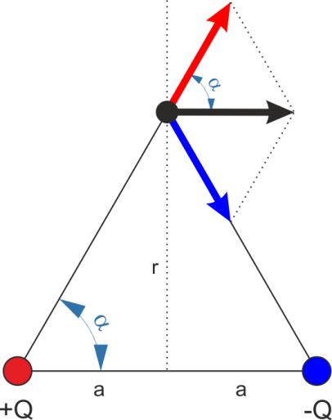



An Electric Field of a Dipole
$$\vec{E}+$$
A dipole is represented by two charges of the same magnitude and different signs separated by a distance 2a. We will examine electric field on the vertical axis in the middle between the charges. Using principle of superposition:
P
$$\vec{E}$$
$$\vec{E}−$$
The vertical components compensate each other, so the resulting field is
Considering r >>a we can simplify
The dipole moment is

Slide 14

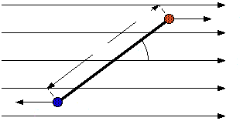




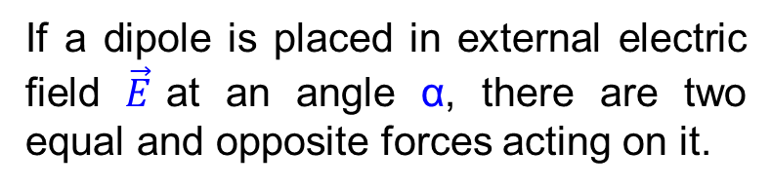





A Dipole in an Electric Field
The dipole moment can be also considered a vector of magnitude 2aQ pointing from the negative charge to the positive one.
$$\vec{p}$$
If a dipole is placed in external electric field $\vec{E}$at an angle α, there are two equal and opposite forces acting on it.
$$+Q$$
$$\vec{F}$$
$$2a$$
$$α$$
$$0$$
$$\vec{E}$$
$$−\vec{F}$$
$$−Q$$
The net force is zero but there is a torque τ about the axis through 0.
After substituting
we obtain
The equation can be also written in vector notation

Slide 15








A Dipole in an Electric Field
Work W must be done to change the orientation of the dipole in an external field. This work is stored as potential energy U. The reference angle for zero potential energy is α=90°.
$$+Q$$
$$\vec{F}$$
$$2a$$
$$α$$
$$0$$
$$\vec{E}$$
$$−\vec{F}$$
$$−Q$$
Rewritten in the vector form

Slide 16
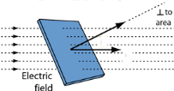
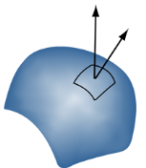


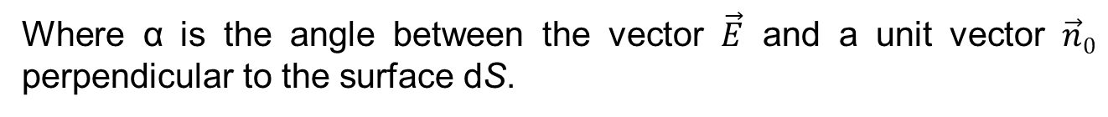






Gauss’s Law and Electric Flux
Let the surface be divided into elementary surfaces dS, small enough to be considered a plane. Electric field can be then taken as a constant for the surface. Electric flux through this area is
$$\vec{n0}$$
$$α$$
$$\vec{E}$$
$$dS$$
Where α is the angle between the vector $\vec{E}$ and a unit vector $\vec{n}0$ perpendicular to the surface dS.
The elementary surface can be also written as a vector
$$\vec{E}$$
$$d\vec{S}$$
The formula for the electric flux can be then written in vector form
$$α$$
The total electric flux through an area S is given by
$$S$$

Slide 17
Gauss’s Law and Electric Flux
Let us discuss a closed surface surrounding some volume. The electric flux through the surface is
The flux through a surface is proportional to the number of electric field lines through it. If the number of lines entering the volume is equal to the number of lines leaving the volume then there is no net flux out of this surface. The flux Φ_{E} will be nonzero only if some lines start or end within the volume. Since the lines start or end only on electric charge, the flux will be nonzero only if the S encloses a net charge.
The Gaus’s law can be formulated by: Electric flux through a closed surface equals to the net charge enclosed by that surface divided by a permittivity of free space.

Slide 18
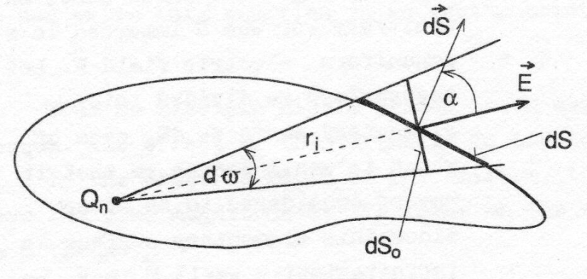
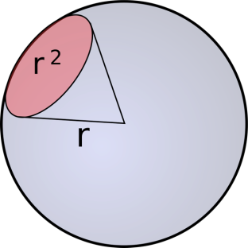
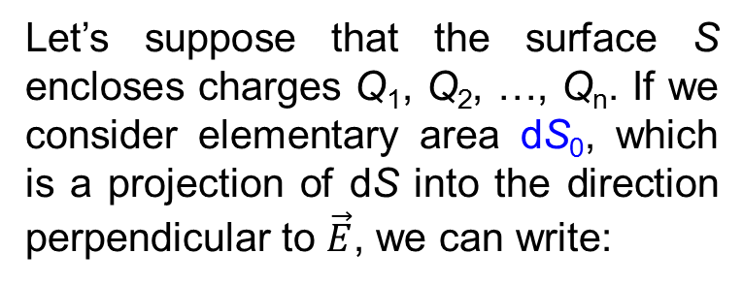
Gauss’s Law - deduction
Let’s suppose that the surface S encloses charges Q₁, Q₂, …, Q_{n}. If we consider elementary area dS₀, which is a projection of dS into the direction perpendicular to $\vec{E}$, we can write:
Taking into account
we can write
1 steradian

Slide 19
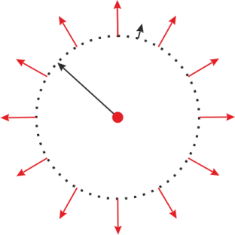
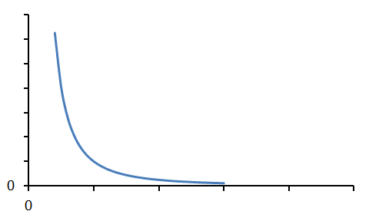
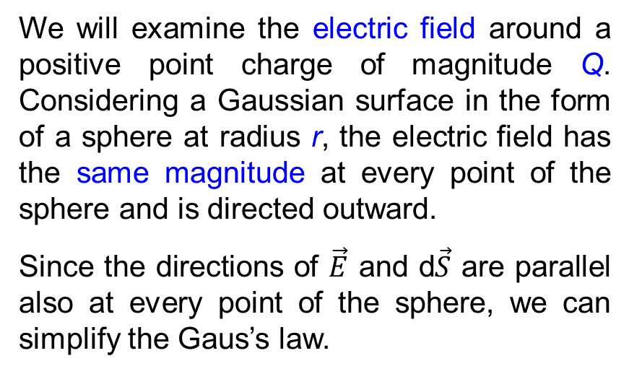


Application of Gauss’s law – a point charge
We will examine the electric field around a positive point charge of magnitude Q. Considering a Gaussian surface in the form of a sphere at radius r, the electric field has the same magnitude at every point of the sphere and is directed outward.
Since the directions of $\vec{E}$ and d$\vec{S}$ are parallel also at every point of the sphere, we can simplify the Gaus’s law.
$$d\vec{S}$$
$$\vec{E}$$
r
Q
E
The electric field at radius r is then given by
r

Slide 20

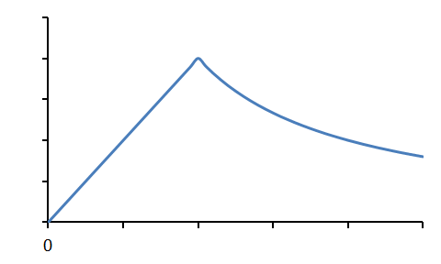
Application of Gauss’s law – a sphere of uniform charge
Now we have a dielectric sphere of radius R charged with uniform charge density ρ of the total magnitude Q.
When inside the sphere (r<R) we are not surrounding the entire charge Q but only a part of it Q’.
$$d\vec{S}$$
$$\vec{E}$$
r
R
Q
while
E
Finally we can write for r<R
For r>R we can use the same formula like for the point charge.
R
r

Slide 21
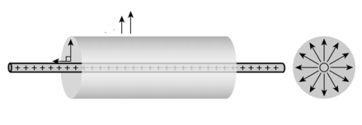
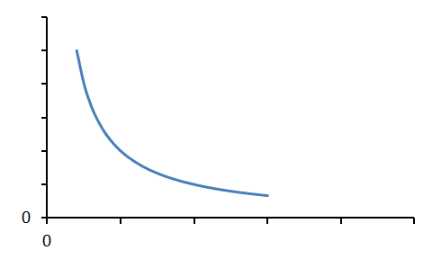
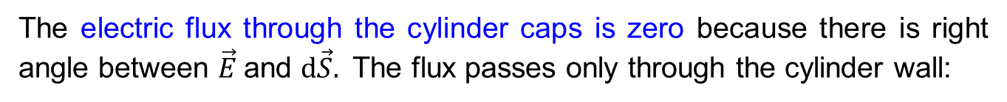




Application of Gauss’s law – a charged wire
We are examinig electric field around a long wire charged with linear density τ. In this case we choose Gaussian surface as a cyliner centered around the wire or radius r and length L.
$$\vec{E}$$
$$d\vec{S}$$
$$\vec{E}$$
$$d\vec{S}$$
r
L
The electric flux through the cylinder caps is zero because there is right angle between $\vec{E}$and $d\vec{S}.$ The flux passes only through the cylinder wall:
The charge surrounded by the cylinder is Q=τ·L
E
The electric field at the distance r is given by
r

Slide 22
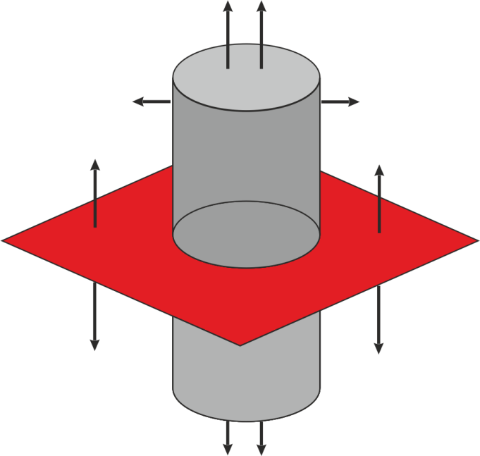








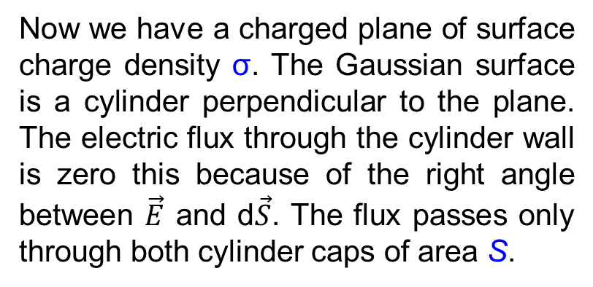


Application of Gauss’s law – an infinite charged plane
$$d\vec{S}$$
$$\vec{E}$$
Now we have a charged plane of surface charge density σ. The Gaussian surface is a cylinder perpendicular to the plane. The electric flux through the cylinder wall is zero this because of the right angle between $\vec{E}$ and d$\vec{S}$. The flux passes only through both cylinder caps of area S.
$$d\vec{S}$$
S
$$d\vec{S}$$
$$\vec{E}$$
$$\vec{E}$$
S
$$\vec{E}$$
$$\vec{E}$$
$$d\vec{S}$$
$$\vec{E}$$
The electric field is given by
We can note that the electric field around an infinite charged plane is constant and does not depend on the distance from the plane. The electric field is homogeneous.

Slide 23
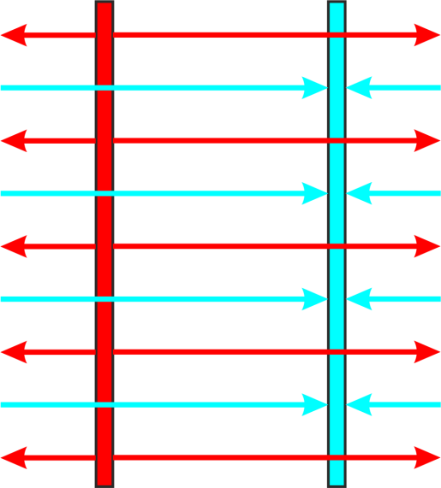


Application of Gauss’s law – two parallel charged planes
+σ
-σ
This is the case of two parallel charged infinite planes of the same charge density σ and different charge signs.
We can see that the force lines to the left from positive plane and to the right from negative plane compensate each other so the electric field outside the planes must be zero.
$\vec{E}$₊
$\vec{E}$₋
We can also see that the density of force lines between planes is doubled compared to the single plane. This means that if the electric field caused by a single plane is E_{s} then the electric field E between planes must be 2E_{s}.
The electric field between infinite parallel planes is also constant and does not depend on the position between planes.

Slide 24
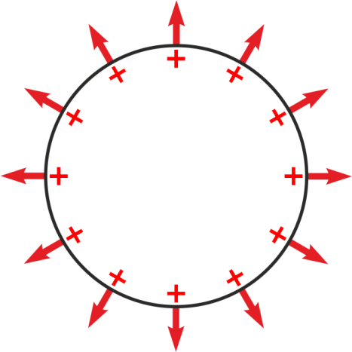




Electric Field and Conductors
1. The net electric charge of a conductor resides entirely on its surface. The mutual repulsion of like charges from Coulomb's Law demands that the charges be as far apart as possible, hence on the surface of the conductor.
$$\vec{E}$$
$$\vec{E}$$
$$\vec{E}$$
2. The electric field inside the conductor is zero. Any net electric field in the conductor would cause charge to move since it is abundant and mobile. This would violate the condition of equilibrium: net force = 0.
$$\vec{E}$$
3. The external electric field at the surface of the conductor is perpendicular to that surface. If there were a field component parallel to the surface, it would cause mobile charge to move along the surface, in violation of the assumption of equilibrium.

Slide 25
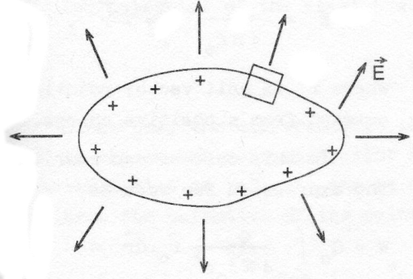
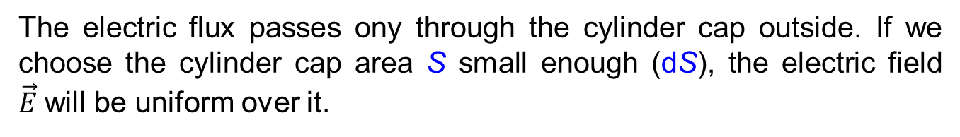

Electric Field Around a Conductor
Our Gaussian surface will be a small cylinder perpendicular to the surface. One cap of the cylinder will be just above the surface and the other just below the surface.
The electric field is zero inside the conductor and is perpendicular to the surface just outside it.
$$d\vec{S}$$
The electric flux passes ony through the cylinder cap outside. If we choose the cylinder cap area S small enough (dS), the electric field $\vec{E}$will be uniform over it.
where σ is the surface charge density at the place of cylinder.
The electric field at surface of conductor is then

Slide 26
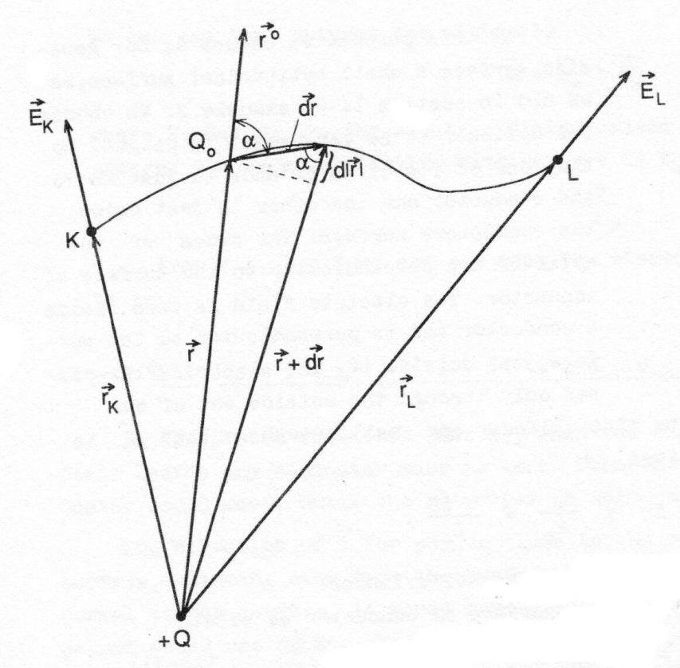
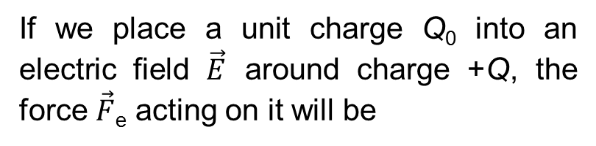
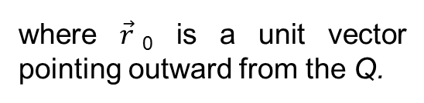
Work and Potential in an Electric Field
If we place a unit charge Q₀ into an electric field $\vec{E}$ around charge +Q, the force $\vec{F}$_{e} acting on it will be
The work done by this force to move the unit charge Q₀ from point K to L is:
An electric field due to a point charge Q is:
where $\vec{r}$₀ is a unit vector pointing outward from the Q.

Slide 27
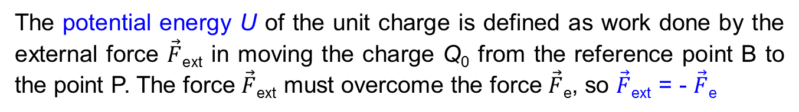
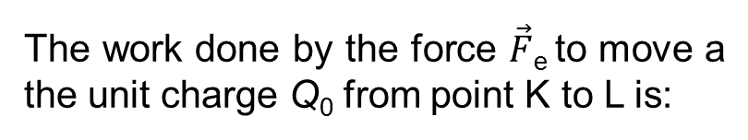
Work and Potential in an Electric Field
The work done by the force $\vec{F}$_{e} to move a the unit charge Q₀ from point K to L is:
We can note that the work W does not depend on the path taken, it depends only on the initial and final position. This also means that it we return back from L to K by a different path, the total work done will be zero. These are properties of conservative field.
The potential energy U of the unit charge is defined as work done by the external force $\vec{F}$_{ext} in moving the charge Q₀ from the reference point B to the point P. The force $\vec{F}$_{ext} must overcome the force $\vec{F}$_{e}, so $\vec{F}$_{ext} = - $\vec{F}$_{e}
The potential energy for U_{B}=0 is then
The electric potential is defined as potential energy per unit positive charge.

Slide 28
Work and Potential in an Electric Field
The unit of electric potential is Volt [V]. If we want to express the potential difference between points K and L, we can write:
We can evaluate an expression for the potential at the point L .
For convenience we often place the reference point K to the infinity and we consider the potential to be zero here. Then we can simplify:
To calculate a potential due to a group of charges we can use the superposition principle by simple adding particular potentials φ_{i} due to each charge.
In case of uniform charge distribution we must integrate to determine the potential.

Slide 29
Electric Field and Potential
To find the relation between the electric field and potential we will consider two nearby points (x,y,z) and (x+dx,y+dy,z+dz). The potential change from the first point to the second is:
We also know that
and
Expressions for dφ can be compared
We can finally write

Slide 30
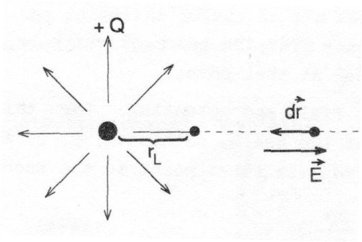
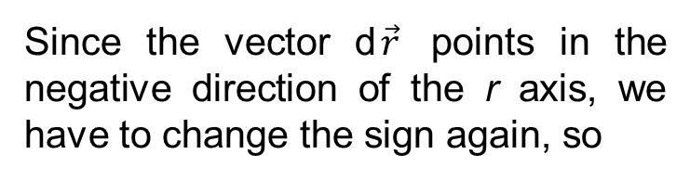
Example - electric potential around a point charge
Determine the potential φ at a distance r_{L} from a positive single point charge.
L
The magnitude of electric field due to a positive point charge is:
The potential is given by
The scalar product
Since the vector d$\vec{r}$ points in the negative direction of the r axis, we have to change the sign again, so
The potential is equal to

Slide 31
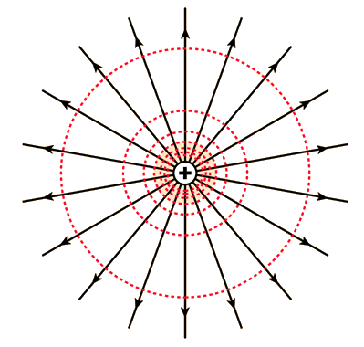
Example - electric potential around a point charge
The electric potential due to a point charge was deduced as
This is a dependence dropping hyperbolically and we can see from the formula that the surfaces with constant φ are concentric spherical areas.
These areas are called equipotential surfaces in the 3D case or equipotential lines in the 2D case. The equipotentials for the point charge configuration are shown on the picture by dashed lines.
Higher concentration of equipotentials mean higher electric field intensity and vice versa.

Slide 32
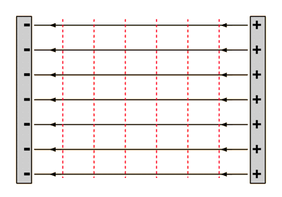
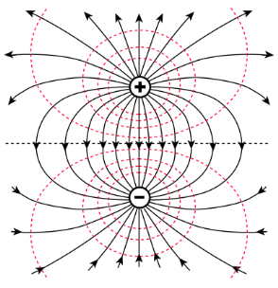
Graphical Interpretation of Electric Potential
In case of two large parallel charged plates of different signs we can see that equipotential surfaces are represented by planes parallel with the plates (dashed lines). The electric potential changes linearly here.
A
d
B
The next picture shows electric field and equipotentials (dashed) for the electric dipole.
There is always right angle between force lines and equipotential lines.

Slide 33
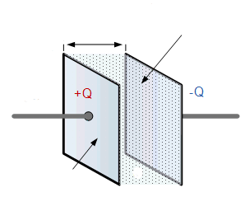

Capacitance
We have two large parallel conductive plates of the same charge density σ but different charge sign. The area of each plate is S, their distance is d and the space between them has permittivity ε₀.
dielectric
d
lead
$$\vec{E}$$
We already know that the electric field between such plates is
ε₀
Plate A,
σ+, area S
Plate B,
σ-, area S
The potential difference V= φ_{A}-φ_{B} is called voltage. The voltage between the plates is
The proportionality between voltage and charge can be expressed by a constant C
The constant C is called capacitance and for the parallel plate confirugation it is equal

Slide 34
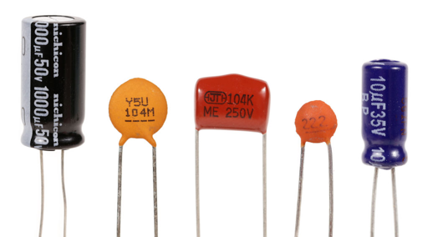
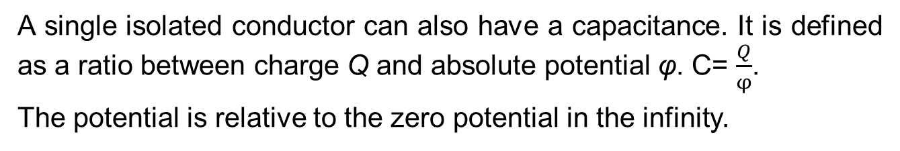
Capacitance
A system of two isolated conductors is called a capacitor and the unit of its capacity is Farad.
A single isolated conductor can also have a capacitance. It is defined as a ratio between charge Q and absolute potential φ. C= $\frac{Q}{φ}$.
The potential is relative to the zero potential in the infinity.
The unit of Farad is too large in practice. The capacity of the most common capacitors for electronics (on the picture) ranges from pF (10⁻¹² F) to µF (10⁻⁶ F). An electric power line has a capacity to ground in units of nanofarads per kilometer (1nF= 10⁻⁹ F).

Slide 35

Capacitor as Energy Storage
The energy stored in a capacitor is equal to work done to charge it. Charging means removing a charge from one plate and adding it to another. The work needed to transport a small amount of charge dq when a potential difference V is present on the plates is
Since V=$\frac{Q}{C}$ then the work done is
The work done is equal to electrical potential energy stored.
after substituting

Slide 36
Energy Stored in a Parallel Plate Capacitor
From the previous we know relations for the electric field between charged parallel plates and for capacitance.
Then we can write for the potential energy
The product S∙d represents a volume between the plates. If we divide both sides of the equation by the volume, we obtain energy density w.
Although the formula for w was deduced for the case of the parallel plate capacitor, it is valid for any region where the electric field is present.

Slide 37
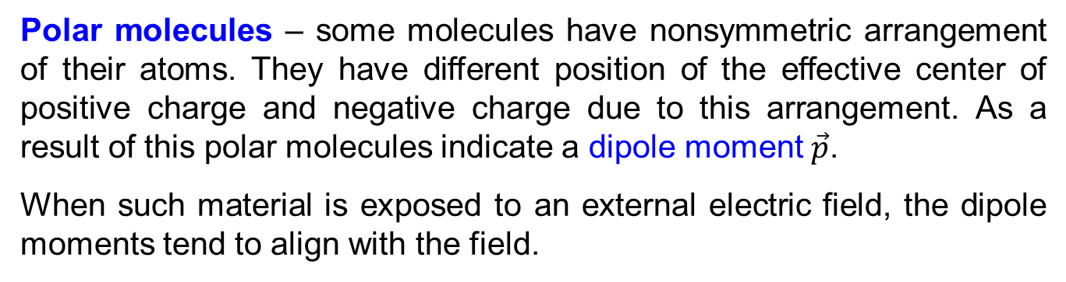
Dielectrics
In this part we will discuss insulators or dielectrics – materials, which do not conduct electricity.
What happens when we place a dielectric material in an electric field?
The answer depends on the type of used material and its molecules, we distinguish between
Polar molecules
Nonpolar molecules
Polar molecules – some molecules have nonsymmetric arrangement of their atoms. They have different position of the effective center of positive charge and negative charge due to this arrangement. As a result of this polar molecules indicate a dipole moment $\vec{p}$.
When such material is exposed to an external electric field, the dipole moments tend to align with the field.

Slide 38




Dielectrics
A typical polar molecule is water molecule H₂O. Oxygen nucleus with 8 protons is much stronger in attraction of electrons then hydrogen atoms with 1 proton each. This fact means that the position of the center of negative charge is closer to the oxygen nucleus then the position of the center of positive charge.
Center of - charge
Oxygen
Center of + charge
+8
+1
+1
$$\vec{p}$$
The dipole moment $\vec{p}$ is marked in the picture. If we apply an external electric field, the moments will tend to align with the field, but the alignment will be only partial and dependent on the field intensity and temperature.

Slide 39


Dielectrics
Nonpolar molecules – we can find them in some gases. The molecules are symmetrical, so positions of centers of charge are the same and there is no dipole moment. We can see it on an oxygen molecule.
Oxygen molecule
If such molecule is exposed to an electric field, negative electrons are pulled one way and positive nuclei are pulled the opposite way. This results in slight net displacement of the charge, so the dipole moment is present as well.
Conclusion: both types of molecules can acquire a dipole moment when placed in an electric field. The dielectrics become polarized.

Slide 40


Dielectrics and a Capacitor
If we have a parallel plate capacitor with vacuum between electrodes, its capacity was deduced as
ε=ε₀
If the space between plates is filled with dielectric the formula changes to
where ε_{r} is a dielectric constant or relative permittivity .
ε= ε_{r}ε₀
If we place the same charge Q on each capacitor and mark corresponding voltages V_{d} (dielectric) and V₀ (vacuum), we can write
From the upper formulae we can deduce
so

Slide 41

Dielectrics and a Capacitor
Our deduced formula for V_{d} shows us that the voltage between plates is lower in case of dielectric compared to the situation with vacuum for the same charge applied.
If we also realize that electric field is directly proportional to the voltage for the parallel plate arrangement V=E∙d, it is obvious that also electric field is weaker in the dielectric. Why?
If we apply an external field to the parallel plate capacitor with dielectric between plates, molecules in the dielectric polarize, which induces an additional surface charge on the dielectric. The positive surface charge equal in magnitude to the negative one. Electric field caused by the surface charge has opposite direction to the external field.

Slide 42





Dielectrics and a Capacitor
$$\vec{E}$$
$$\vec{E}0$$
$$\vec{E′}$$
If we mark the external field $\vec{E}$₀, and the electric field set by the surface charge $\vec{E′}$, then the resultant electric field $\vec{E}$ is given by
Conclusion: if we place a dielectric in an electric field, induced surface charges weaken the original electric field in the dielectric.

Slide 43
Relative Permittivity of Various Materials
Material | Relative permittivity ε_{r}
Air | 1.000536
Body tissue | 8
Concrete | 4.5
Glass | 3.7 – 10
Ice | 3.2
Insulation of cables | 1.5 - 4
Paper | 2.3
Plexiglass | 3.2
Silicon | 12
Vacuum | 1
Water | 4 – 88 (88 at 0°C)

Slide 44

Dielectrics, Capacitor and Gauss’s Law
a)
b)
We have again a comparison between parallel plate capacitor without dielectric (a) and with dielectric (b). If we apply Gauss’s law to the (a) with Gaussian surface defined by the dashed line, we obtain
If we apply Gauss’s law to the (b) we obtain
[1]
Where q is free charge and q’ is induced charge.

Slide 45
Dielectrics, Capacitor and Gauss’s Law
Now we recall previously mentioned formulae
Considering
we can write
Combining with [1] we obtain
Finally
We can note that the flux integral contains a dielectric constant ε_{r} and that the charge within Gaussian surface is only the free charge q. Induced charge is hidden in the ε_{r}.

Slide 46

Polarization and Electric Displacement
Previously we deduced an equation
After small arrangements
The last term $\frac{q′}{S}$ is the induced charge per area. We call it electric polarization P.
Realizing that
we can rewrite the equation to
The term $\frac{q}{S}$ is called electric displacement D.
The final shape of the equation in vector form is

Slide 47


Polarization and Electric Displacement
The displacement and polarization can be demonstrated on a parallel plate capacitor with combination of a gap and dielectric between electrodes. There are some important findings.
Vector $\vec{D}$ is associated only with the free charge.
Vector $\vec{P}$ is associated only with the polarization charge.
Vector $\vec{E}$ is associated with all present charges.
Vector $\vec{P}$ vanishes outside the dielectric, vector $\vec{D}$is not affected by the environment and vector $\vec{E}$ has different magnitudes in the gap and in the dielectric.

Slide 48
Polarization and Electric Displacement
If we combine previously deduced formulae
we can write
In vector form it is
The polarization can be written as
And in vector form
Finally we can formulate the Gauss’s law for the electric displacement

Slide 49
Summary – what we have learnt
Coulomb’s law
A force acting on a charge in an electric field
Gauss’s law
Relations between potential and electric field
Relations between electric field, electric displacement and polarization
Energy stored in a capacitor
Energy density of electric field

Slide 50


Example – Electric field on the axis of charged ring
Given: ring radius R, charge q. E(z)=?
Magnitude of the electric field at the point P due to the element ds from the Coulomb’s law:
Horizontal component of d$\vec{E}$ is compensated by the element on the opposite side of the ring, so only vertical component dEcosΘ can be taken into account.

Slide 51

Example – Electric field on the axis of charged ring
A graph for q= 4 μC, R= 2 cm.
Important points and limits
The maximum for
For z >>R
z_{m}

Slide 52

Example – Electric field on the axis of charged disc
Given: disc radius R, surface charge density σ. E(z)=?
A charge contribution from the elementary ring of radius r is
Using a formula for charged ring we can write
We substitute

Slide 53

Example – Electric field on the axis of charged disc
Important points and limits
A graph for σ = 5 μC/cm², R= 10 cm.

Slide 54

Example – Concentric spheres
A conducting sphere of radius R₁ is surrounded by a concentric dielectric layer of outer radius R₂ and permitivity ε₂. The surrounding medium has permitivity ε₁<ε₂. Find the dependence of electric displacement, electric field and potential on the distance from the center of the sphere charged to the charge Q. D(r)=?, E(r)=?, φ(r)=?
ε₁
R₂
ε₂
R₁
metal
Electric displacement
Gauss’s law simplified for the concentric arrangement
for r>R₁
Since the charge inside the sphere is zero, then
for r<R₁
Electric field

Slide 55
Example – Concentric spheres
Electric field in the sphere
Charge inside the sphere is zero, so
for r<R₁
Electric field in the dielectric
for R₁<r<R₂
Electric field outside the dielectric
for r>R₂
Potential
for r<R₁

Slide 56
Example – Concentric spheres
Potential
for R₁<r<R₂
for r>R₂

Slide 57



Example – Concentric spheres
D
for r<R₁
for r>R₁
R₁
R₂
r
E
for r<R₁
for R₁<r<R₂
for r>R₂
R₁
R₂
r
φ
for r<R₁
for R₁<r<R₂
R₁
R₂
r
for r>R₂

Slide 58

Example – Coaxial capacitor
Determine a formula for the capacitance of a cylindrical capacitor of radii R₁, R₂, length l and permitivity of the dielectric ε. We assume that inner conductor is charged to +Q and outer one to –Q.
From the Gauss’s law
The voltage between the cylinders
The capacitance
Example: l=1 m, R₁=1 mm, R₂=3 mm, ε_{r}= 3. The capacitance of such cable is C= 152 pF.

Slide 59

Example – Spherical capacitor
Determine a formula for the capacitance of a spherical formed by two concentric spheres of radii R₁ and R₂. P permitivity of the dielectric is ε. We assume that inner sphere is charged to +Q and outer one to –Q.
From previous deductions we know
The voltage between the spheres
The capacitance
Example: R₁=1 cm, R₂=2 cm, ε_{r}= 3. The capacitance of such capacitor is C= 667 pF.

