Slide 1
Magnetic field
Physics 1
Ing. Jaroslav Jíra, CSc.

Slide 2
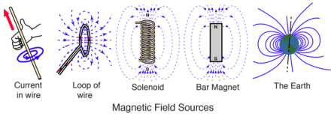
Magnetic Field
A magnetic field is a vector field that describes the magnetic influence of electric charges in relative motion and magnetized materials.
Magnetic fields are produced by electric currents, which can be macroscopic currents in wires, or microscopic currents associated with electrons in atomic orbits.

Slide 3
Magnetic Field, Definition of $\vec{B}$
If we place a test charge q in the electric and magnetic field, the force acting on the charge will have two components.
Electric force, which depends only on the electric field and is independent on the motion of the charge. The electric force is also straightforward.
Magnetic force, which depends on the magnetic field and on the velocity of the charge. The magnetic force is also at the right angles with the velocity.
To be able to describe the magnetic force, let us define the magnetic induction $\vec{B}$. The unit of $\vec{B}$ is Tesla. 1T= $\frac{1Wb}{m^{2}}$ = $\frac{1N}{A∙m}$
Older, but still frequently used unit is Gauss; 1T= 10 000 G
The electromagnetic force acting on the charge q is called Lorentz force and can be written as

Slide 4
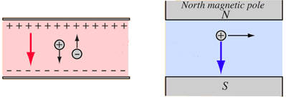
Magnetic Field, Definition of $\vec{B}$
$$\vec{F}m$$
$$\vec{v}$$
$\vec{F}e$ =q $\vec{E}$
$$\vec{E}$$
$\vec{F}$_{e}
$\vec{F}m$= q ($\vec{v}×$ $\vec{B}\text{)}$
$\vec{F}$_{e}
$$\vec{B}$$
Since the magnetic force is always at right angles with the direction of motion, then the work done on the particle is always zero.
This means that the static magnetic field cannot change the kinetic energy of the particle, it can only change the direction of motion.
How to determine the direction of magnetic force $\vec{F}m$?
We can use either a right hand rule or a screw rule.

Slide 5
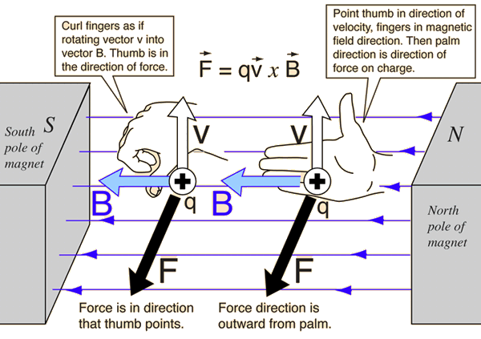
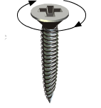
Direction of Magnetic Force
Right hand rule
Screw rule
$\vec{F}m$= q ($\vec{v}×$ $\vec{B}\text{)}$
$$\vec{F}m$$
$$\vec{v}$$
$$\vec{B}$$
If we are looking for the direction of a vector resulting from a vector product, it is obvious that the resulting vector is perpendicular to the plane where the vectors in product are positioned.
Screw rule – if we rotate a right handed screw in the direction from the first vector to the second one by the shortest way, the screw will move in the direction of resulting vector.

Slide 6
Examples of magnetic field strength
Source | B
Magnetic field of Earth (0° lat, 0° lon) | 32 μT
Refrigerator magnet | 5 mT
Solar sunspots | 0.3 T
Surface of a neodymium magnet | 1.25 T
Coil gap of a loudspeaker magnet | 1 – 2.5 T
Superconducting electromagnets | up to 40 T
White dwarf star | 100 T
Magnetar neutron stars | 10⁸ – 10¹¹ T

Slide 7
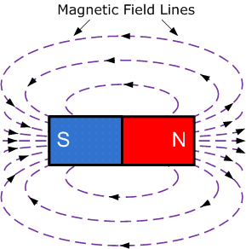
Magnetic Field Lines
Similarities to electric lines
A line drawn tangent to a field line is the direction of the $\vec{B}$ at that point.
The density of field lines still represent the strength of the field
Differences
The magnetic field lines do not start and do not terminate on anything. They form closed loops. There is no magnetic analog of electric charge.
They are not perpendicular to the surface of the ferromagnetic material.
They do not stop on the surface of ferromagnetic material
Magnetic dipole

Slide 8
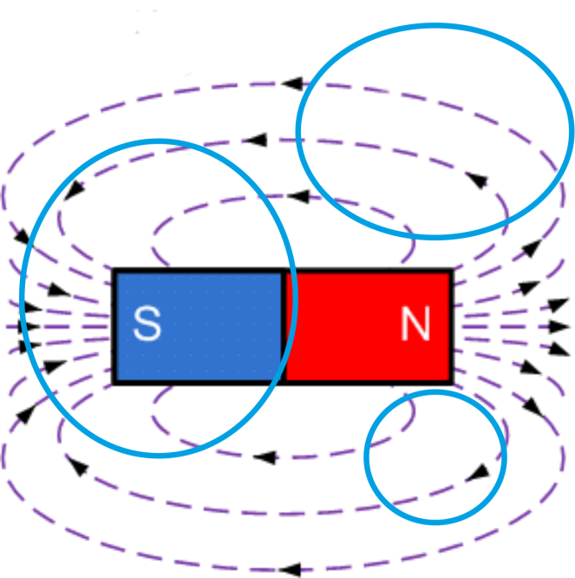
Magnetic Flux
Similarly to the electric field we can define the magnetic flux.
A unit of magnetic flux is Weber [Wb].
As far as the magnetic field lines make closed loops and there is no magnetic charge, all field lines entering a closed surface must also leave it. We can define a Gauss’s law for the magnetic field.
The magnetic flux through a closed surface equals to zero.
This is also known as fourth Maxwell’s equation

Slide 9
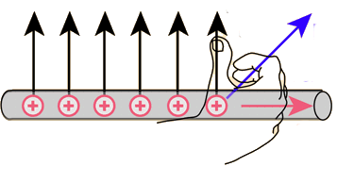
Magnetic Force on a Current
An electric current can be understood as a set of moving electric charges. If the magnetic field exerts a force on a moving charge, then it also exerts force on a wire carrying electric current.
Let us define a differential element of a wire of length $\left|\vec{dl}\right|$ carrying a steady current I and placed in magnetic field B. The vector $\vec{dl}$ indicates the direction of the current flow.
$$\vec{B}$$
$$dQ$$
I
$$\vec{dl}$$
The elementary magnetic force is
From the definition of current and velocity we can write
The elementary force is then
The total force acting on a conductor of the length l:

Slide 10
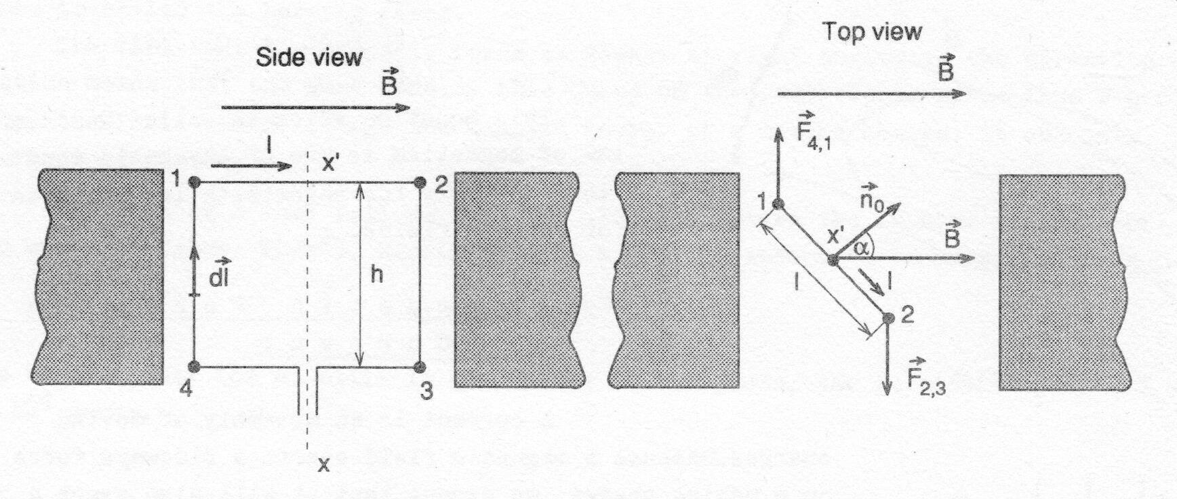
Torque on a Current Loop
We have a rectangular loop of height h and length l in a uniform field $\vec{B}$. The loop carries a current I and it can rotate about an axis x – x’.
The orientation of the loop with respect to the $\vec{B}$ is given by an angle α between $\vec{B}$ and the vector $\vec{n0}$of the normal to the loop.
Using previously deduced formula we can see that
the forces due to arms 1-2 and 3-4 are equal in magnitude and in opposite directions so they compensate each other – no net force. They also have the same line of action so there is no net torque.

Slide 11
Torque on a Current Loop
Forces $\vec{F}$₄₁ and $\vec{F}$₂₃ have the same magnitude, opposite directions and they do not act along the same line, so there is no net force but they produce a torque τ_{m}.
where S= l$∙h$ is the area of the loop. We can now define a magnetic dipole moment of the loop:

Slide 12
Torque on a Current Loop
The formula for the torque can be further rewritten in the scalar and vector form:
We will assume that the magnetic potential energy U is zero when $\vec{μ}$ and $\vec{B}$ are at right angles (α=90°). The potential energy is equal to work W to rotate the dipole from zero position to α.
In vector form
This relation is equivalent to the energy of electric dipole

Slide 13
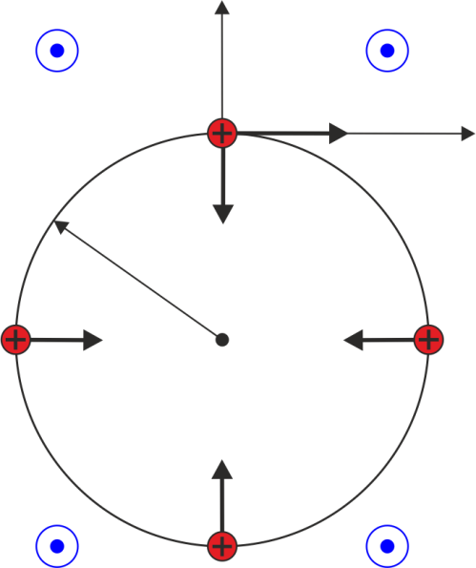
Charged Particle in Magnetic Field
We will examine now what happens when a positively charged particle (Q) enters a magnetic field with initial velocity $\vec{v}$ perpendicular to the $\vec{B}$.
y
$$\vec{B}$$
$$\vec{B}$$
Q
$$\vec{v}$$
x
$$\vec{F}$$
Let us assume for the initial time t=0
R
$$\vec{F}$$
$$\vec{F}$$
According to the Lorentz force and Newton’s laws
$$\vec{F}$$
$$\vec{B}$$
$$\vec{B}$$
Since the $\vec{r}$ and $\vec{v}$have only x and y components, we can simply decompose to x and y components.
After the time integration we obtain

Slide 14
Charged Particle in Magnetic Field
For the magnitudes of velocity we can write
This is an equation of a circle with radius R shifted on the y axis by y_{c}.
The period of revolution and frequency called cyclotron frequency can be expressed as
Example: for an electron entering the field B= 0.1T with velocity v=10⁴ m/s we have

Slide 15
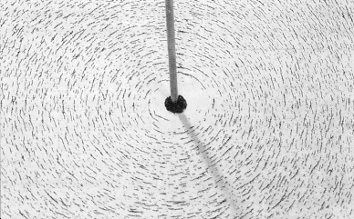
Ampere’s Law
An experiment with iron sawdust placed on a piece of paper around a wire carrying electric current perpendicular to the paper shows us that the force lines of magnetic field are circular with the center at the position of the wire.
Another experiments found that the magnetic induction is directly proportional to the current I flowing through the wire and inversely proportional to the distance r from the wire.
The constant of proportionality was defined as
where μ₀ is permeability of vacuum.
The complete relation for the magnetic induction around the wire is

Slide 16
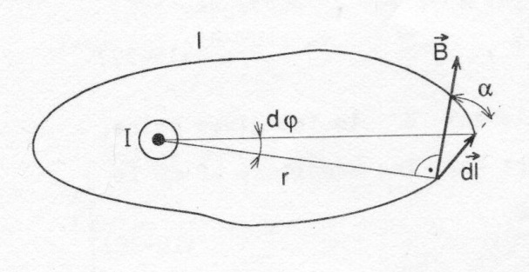
Ampere’s Law
The previously found formula is valid only for the symmetrical circular arrangement. The Ampere’s law describes more general situation. Let us consider any closed path around the conductor.
Let us determine the length integral
We can see from the figure
Using the known formula for B.
So the Ampere’s law is
It is also known as the first Maxwell equation

Slide 17
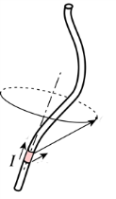
Biot-Savart Law
The Ampere’s law could become difficult to apply in case of more complicated shapes of the wire. For these cases we have a magnetic equivalent of Coulomb’s law named Biot-Savart law.
We will examine the magnetic induction at the point P around the wire carrying the current I. The contribution d$\vec{B}$ of the infinitesimal element d$\vec{l}$ is
P
α
d$\vec{l}$
$$\vec{r}$$
$$\vec{B}$$
$\vec{r}$₀
or
where $\vec{r}$₀ is a unit vector in the direction of $\vec{r}$ and r =$\left|\vec{r}\right|$.
The magnitude of d$\vec{B}$can be expressed by
To be able to determine the magnetic induction $\vec{B}$at P due to the whole wire, we have to integrate along the entire length l.

Slide 18
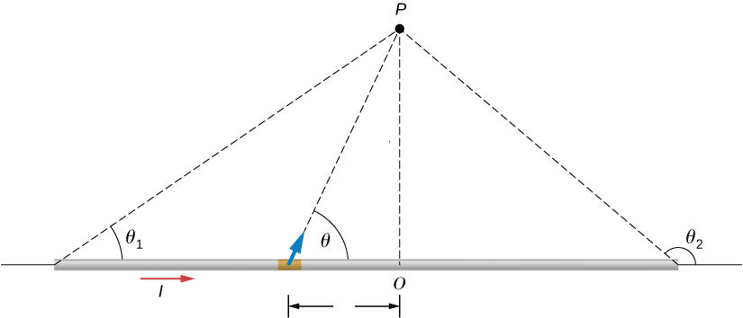
Application of Biot-Savart Law – long straight wire
Determine the magnitude of $\vec{B}$at a distance R from the center of a long cylindrical wire carrying a current I.
r
R
$\vec{r}$₀
$$d\vec{l}$$
-l

Slide 19
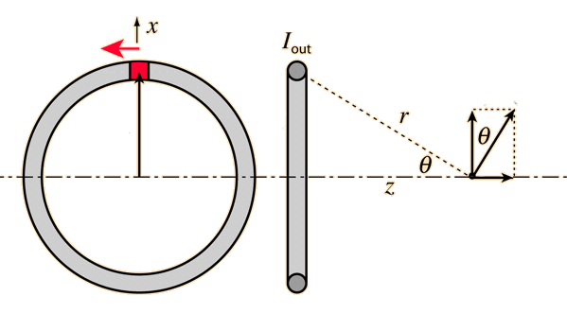
Application of Biot-Savart Law – circular wire
Determine the magnitude of $\vec{B}$on the axis of circular loop of radius R carrying a current I.
I
dl
dφ
R
dB_{x}
d$\vec{B}$
R
P
dB_{z}
Vertical component dB_{x} is compensated by the element on the opposite side of the ring, so only horizontal component dB_{z}=dBsinΘ can be taken into account.

Slide 20
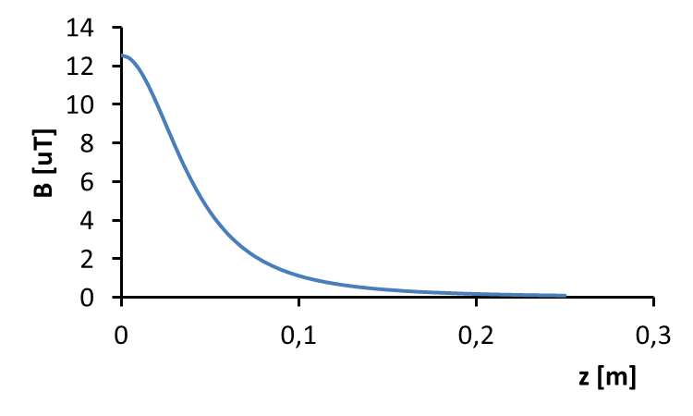
Application of Biot-Savart Law – circular wire
We found the formula for the magnitude of magnetic induction.
If we realize that the sin Θ can be expressed as
we can rewrite the result
A graph for I= 1A, R= 5cm
Important points and limits

Slide 21
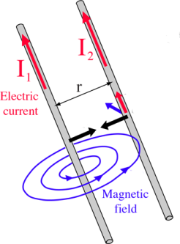
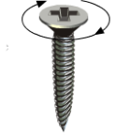
Magnetic Force Between Wires
The magnetic field of an infinitely long straight wire carrying I₁ can be obtained by applying Ampere's law.
$$\vec{B}$$
I$\vec{dl}$
$$\vec{F}2$$
$\vec{F}$₁
A force exerted on the wire with I₂ can be obtained as the Lorentz force.
Taking into account that $\vec{B}$ and $\vec{dl}$ are always perpendicular to each other, we can simplify to the relation of the force on length L.
We can see by the screw rule or right hand rule that parallel current causes attractive force and antiparallel current causes repulsive force.

Slide 22
Magnetic Force Between Wires
The attraction between two long parallel wires is used to define the current 1 Ampere.
If we have two parallel wires 1 meter apart and the currents I₁ and I₂ are equal and of the same direction, then the current causing the attractive force F= 2$×$10⁻⁷ N/m is defined to be 1 Ampere.
The magnetic force and knowlegde of it is very important in the power circuit design, especially for the cable installation and fixation.
Let us suppose, that there is a device powered by two DC cables (plus and minus) and in case of short circuit the current flowing through cables would be 30 kA. If the cables are installed parallelly 5 cm apart, then the repulsive force between them would be 3600 N per one meter of length!!

Slide 23
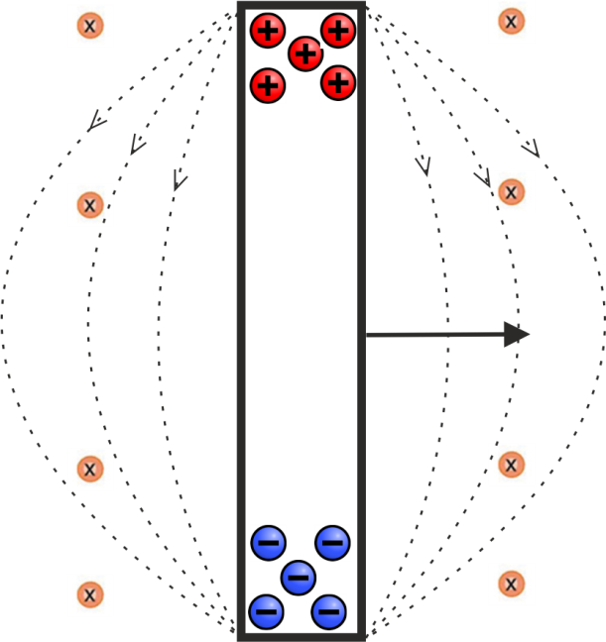
Electromagnetic Induction
Let us consider a conductor (a bar) placed in a uniform magnetic field $\vec{B}$. If we set the conductor in motion with velocity $\vec{v}$ perpendicular to its own length and to the $\vec{B}$, charged particles in the conductor will experience the Lorentz force
$$\vec{B}$$
$$\vec{E}$$
$$\vec{v}$$
This force pushes positive charges up and negative charges down.
Electrons begin to collect at the bottom part of the conductor leaving the upper part positive. This charge accumulation generates an electric field which acts in the opposite direction by its force. The charge accumulation continues until a balance between electrostatic and magnetic forces is established.
The electric field is then given by

Slide 24
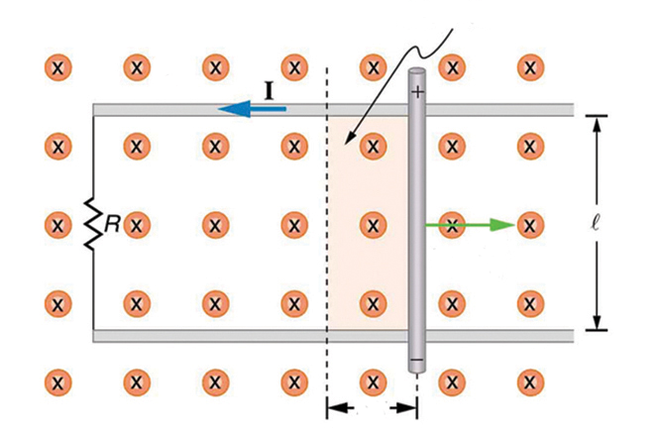
Electromagnetic Induction
The moving conductive bar slides with the velocity $\vec{v}$along a U-shaped conductor with resistor R. Due to the generated electric field the current I is established through the R. The current loweres the accumulated charge while the magnetic force accumulates another charge at the ends if the motion is maintained.
$$dS$$
$$\vec{B}$$
$$\vec{v}$$
$$\vec{F}m$$
$$\vec{F}ext$$
$$ds$$
The force exerted by the magnetic field on the conductor is
An external force maintaining the motion must have the same magnitude and opposite direction
The distance traveled by the conductor in time dt is
The elementary work done by the external force is

Slide 25
Electromagnetic Induction – Faraday’s Law
$$dS$$
$$\vec{B}$$
The product Iˑdt represents an elementary charge dq, so
d
a
$$\vec{v}$$
The induced electromotive force is
$$\vec{F}m$$
$$\vec{F}ext$$
c
b
$$ds$$
When the conductor is moving to the right, the area of a-b-c-d increases by
The change in magnetic flux is then
The induced emf is given by
The last term forms the Faraday’s law

Slide 26
Magnetic Induction – Faraday’s Law
We could see in the previous that the magnetic force $\vec{F}$_{m} caused by the induced electric current was in the opposite direction than the force $\vec{F}$_{ext} causing the motion. This is the principle of the Lenz’s law stating that the direction of induced current is such as to oppose the cause producing it.
The Faraday’s law can be also written in more general form. The emf can be written as
and finally
In combination with previous formulae
This general form is also known as second Maxwell’s equation. The emf will be present regardless the cause of the magnetic flux change. The flux can be changed by moving a loop or a coil in the stationary magnetic field, by moving a permanent magnet, by changing the magnetic induction, by changing the shape of the loop etc.

Slide 27
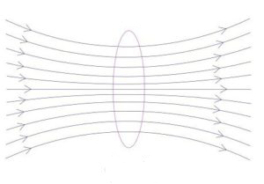
Self Inductance
We have a closed loop l carrying a current I.
Magnetic flux Φ_{B} through a surface S surrounded by the loop is given by
l
S
I
$$\vec{B}$$
Magnetic induction at a given point is according to the Biot-Savart law
By combining of the two previous equations we obtain
If we substitute
we can write
The quantity L is called self-inductance and it depends on the geometry of the wire and on the permeability of the environment.

Slide 28
Self Inductance
A unit of the self-inductance is Henry [H] and can be expressed as
If the current passing through the loop varies in time then the magnetic flux varies as well and induces an emf, which opposes the original current. The value of emf induced in the loop is

Slide 29
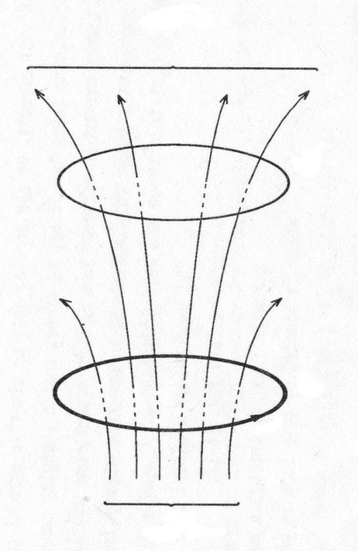
Mutual Inductance
Φ₂₁
Now we have two loops placed near each other. The emf ε₂ induced in the loop 2 is proportional to the rate of change of the Φ₂₁, which is due to the current I₁ in the loop 1.
2
If the loops are fixed in space then the Φ₂₁ is proportional to the I₁, which can be written as
1
I₁
The proportionality constant M₂₁ is called mutual inductance and its unit is also Henry [H].
Φ₁
The emf induced in the second coil is
Similar relation can be written for the situation when the loop 2 carries a current I₂ and we want to express the emf ε₁ in the loop 1.
The mutual inductance is symmetrical, so

Slide 30
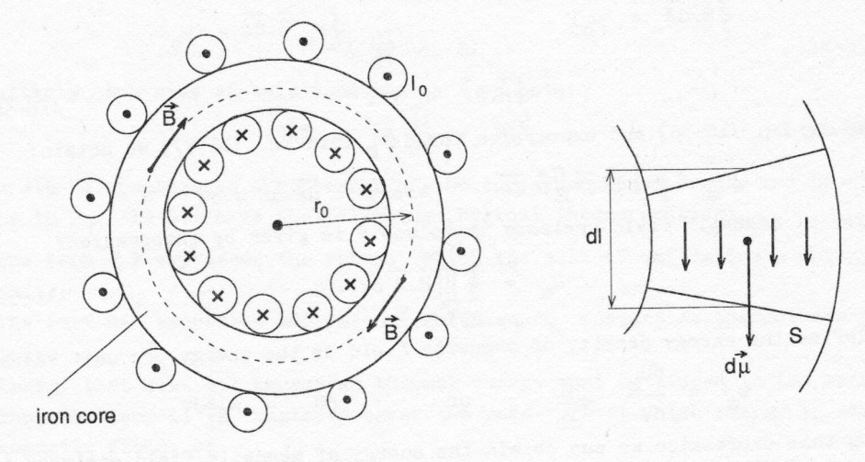
Magnetic Field Strength and Magnetization
Let us discuss the situation when the magnetic field is present in an environment different from vacuum, which was characterized by the permeability of vacuum μ₀. As we have elementary electric dipoles, there exist also elementary magnetic dipoles.
We have a torus carrying a current I₀ with iron core and designed so that the core could be removed. A hypothetical slice out the core has a magnetic dipole moment $\vec{d\text{μ}}$ as a sum of all elementary dipoles in it.
The vector of magnetization is defined as
where S·dl is a volume of the slice
If we remove the iron core, the magnetic induction B inside the torus will significantly decrease for the same current I₀. We would have to increase the current by an amount I_{M} to compensate the drop and to achieve the former magnitude of B.

Slide 31
Magnetic Field Strength and Magnetization
We can see that the Ampere’s law is not valid in the previously written form for the materials with magnetization and it must be modified to
For our torus it can be rewritten to
[1]
where N is the number of turns.
We already know that the dipole moment magnitude is
For the coil with N turns it is
or
Using the definition of M
where the term in the brackets means number of turns associated with the slice dl.

Slide 32
Magnetic Field Strength and Magnetization
The last equation can be simplified to
Substituting into the equation [1] we obtain
In more general form it is
Here we can define the vector of magnetic field strength $\vec{H}$.
Now we can write the Ampere’s law in more simple form valid also for magnetic materials.

Slide 33
Permeability of Materials
As we have relations between permitivities for the electrostatic field, we have similar relations between permeabilities for the magnetic field.
Permeability of a material can be expressed as
where is μ_{r} is dimensionless relative permeability.
The relationship between magnetic vectors can be written also as
According to the relative permeability we can divide magnetic materials into three categories:
Diamagnetics – (μ_{r}<1, slightly). They create weak magnetic field opposite to an externally applied magnetic field.
Paramagnetics - (μ_{r}>1, slightly). They are weakly attracted to magnetic field. Magnetization disappears without external field.
Ferromagnetics - (μ_{r}>>1). Strong magnetization, which retains even after turning the external field off. They can form permanent magnets.

Slide 34
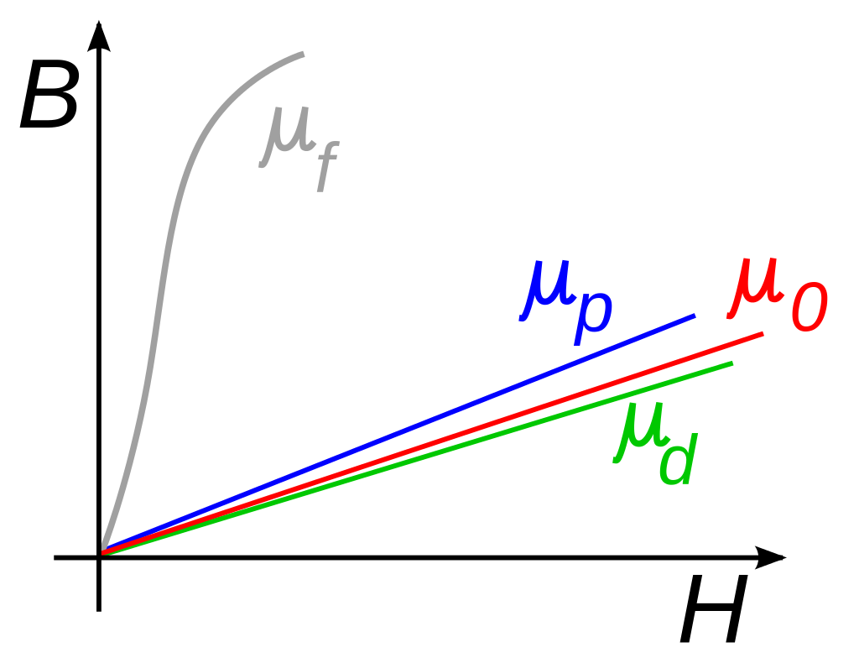
Permeability of Materials
Material | Relative permeability μ_{r}
Bismuth | 0.999834
Water | 0.999992
Copper | 0.999994
Vacuum | 1
Air | 1.00000037
Aluminum | 1.000022
Platinum | 1.000265
Nickel | 100-600
Carbon steel | 100
Iron (99.8%) | 5 000
Iron (99.95%) | 200 000
Comparison between permeabilities of diamagnetics, paramagnetics, ferromagnetics and vacuum

Slide 35
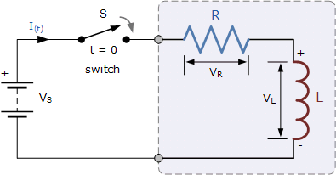
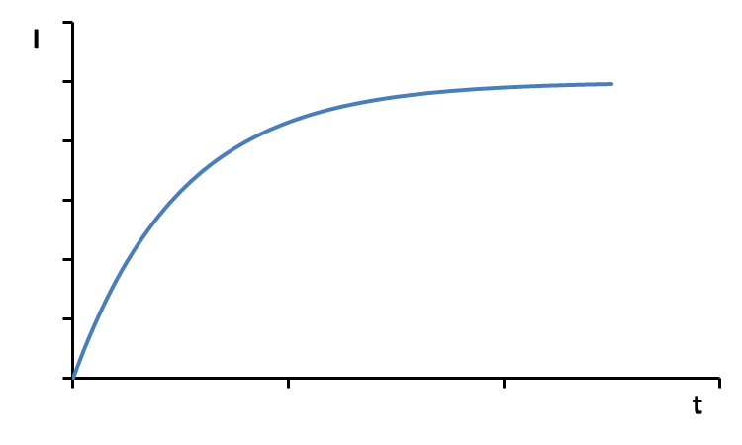
Energy Stored in Magnetic Field
Let us examine a simple circuit consisting of resistor R, inductor L, switch S and DC voltage source V_{s}. When we turn the switch on, the current I starts to rise gradually.
The equation for the voltages is then
I_{max}
If we multiply both sides by I, we obtain
The term V_{s}I expresses the rate at which the source delivers energy to the circuit.
The term RI² expresses the thermal energy in the resistor.
The term LI$\frac{dI}{dt}$ represents the energy of the magnetic field of the coil.

Slide 36
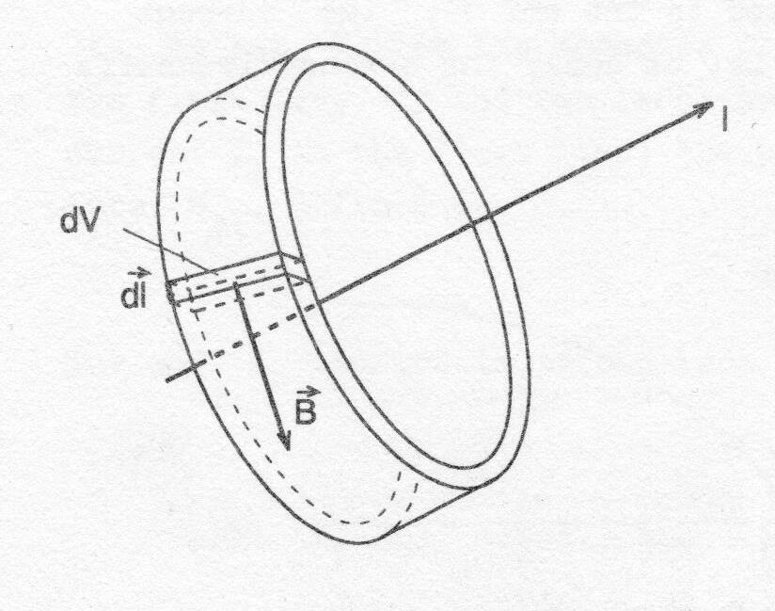
Energy Stored in Magnetic Field
The rate of change of the coil magnetic field energy U_{m} can be written as
This can be simplified as
By integration we obtain
The total magnetic energy stored in an inductor is
Let us deduce the formula for U_{m} with magnetic field vectors. We have a straight wire carrying the current I and around it we chose circular flux tube with cross section S. We know that
S
so

Slide 37
Energy Stored in Magnetic Field
The amount of flux enclosed by the tube is
where
S
The magnetic field energy enclosed in the elementary volume dV is
Using the Ampere’s law
we obtain
Realizing that
we obtain
We can now define energy volume density

Slide 38
Summary – what we have learnt
Lorentz force
Gauss’s law for magnetism
Ampere’s law
Biot-Savart law
Relations between magnetic induction, magnetic field strength and magnetization
Faraday’s law
Energy stored in an inductor
Energy density of magnetic field

Slide 39
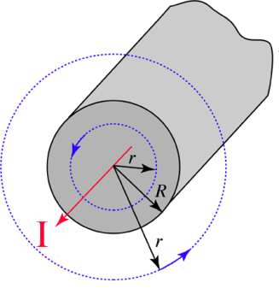
Application of Ampere’s Law – field inside and around a wire
A long straight cylindrical wire of radius R carries a current I uniformly distributed in the cross section area. Determine the magnetic field strength H inside (r<R) and outside (r>R) the wire.
$$\vec{B}$$
a) r>R, we can use Ampere’s law
$$\vec{B}$$
We can simplify it for concentric arrangement
b) r<R, inside the wire we are not surrounding the entire current I, but only a part of it I’, which will be used in te Ampere’s law

Slide 40
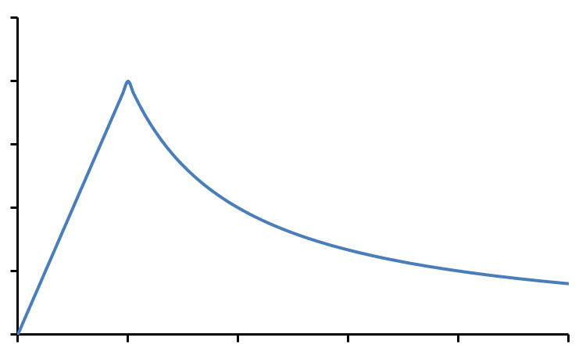
Application of Ampere’s Law – field inside and around a wire
We have found relations for the magnetic field strength inside and outside the wire.
r<R
$$\vec{B}$$
$$\vec{B}$$
r>R
H
0
R
r

Slide 41
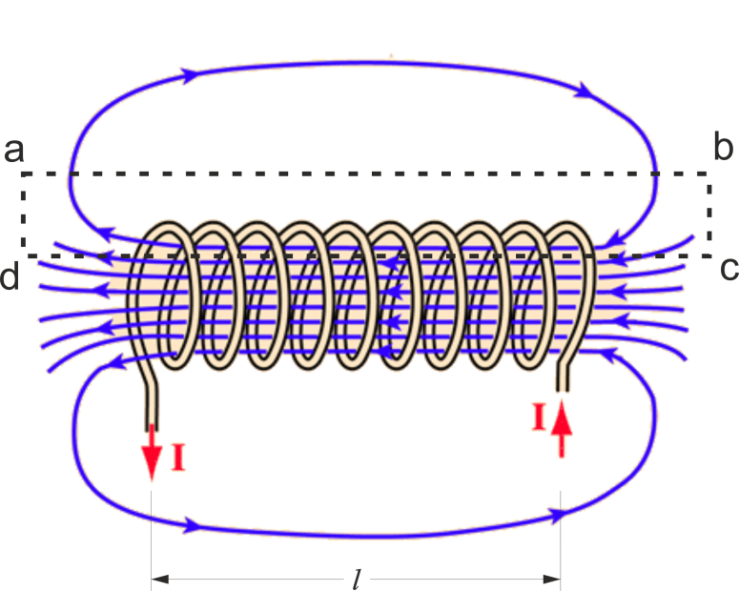
Example – Solenoid
Determine the magnetic induction inside very long solenoid of cross sectional area S, length l, number of turns N carrying current I. Determine also relation for its self inductance.
We will use Ampere’s law.
S
The magnetic field outside long solenoid can be considered zero. Integral a-b is then zero.
The $\vec{B}$ is perpendicular to the $\vec{dl}$ on sections b-c and a-d, so the integrals are also zero. The entire integral reduces to
The total current enclosed by the loop is NI because the loop encloses N turns with current I each. The field inside is homogeneous.

Slide 42
Example – Solenoid
We already know the relation for magnetic flux
In case of a coil we have to count magnetic flux through all turns
For the constant B we can write
so
Substituting expression for B
The self inductance of solenoid is
Example: N=100, d= 1 cm, l= 20 cm
Air core of the solenoid: L= 4.9 μH,
Metal core (μ_{r}= 4000) of the solenoid: L= 19.7 mH

Slide 43
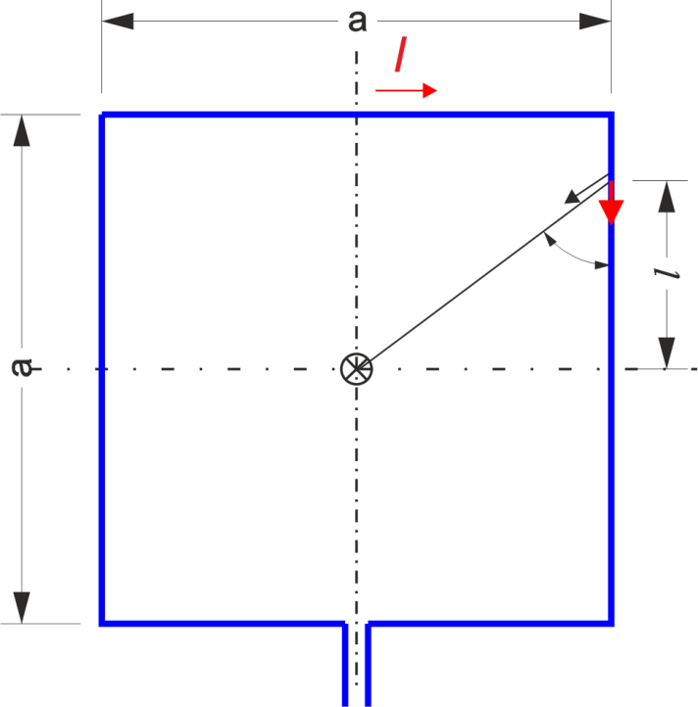
Example – Square Loop
Calculate the magnetic induction B in the middle of a square loop carrying a current I= 30 A. Side of the loop a= 10 cm.
We will divide the loop into eight parts of length a/2. Contribution to the total B of one such part will be B’. Due to the symmetry are contributions of each part in the middle of the square identical in magnitude and direction. Elementary contribution of the element $\vec{dl}$ is
$$\vec{r0}$$
$$\vec{dl}$$
r
α
$$\vec{B}$$
a/2
We will use substitutions

Slide 44
Example – Square Loop
Due to the substitution we obtain
Contribution of one a/2 part is
The total magnetic induction is
Numerical result for given values I=30 A, a= 10 cm

